Slide 1
How to Take Your Twitter Strategy from Meh to Wow!
- Josh Martin, Sr. Director Digital & Social
#shakeupshow
@Jmart730

Slide 2
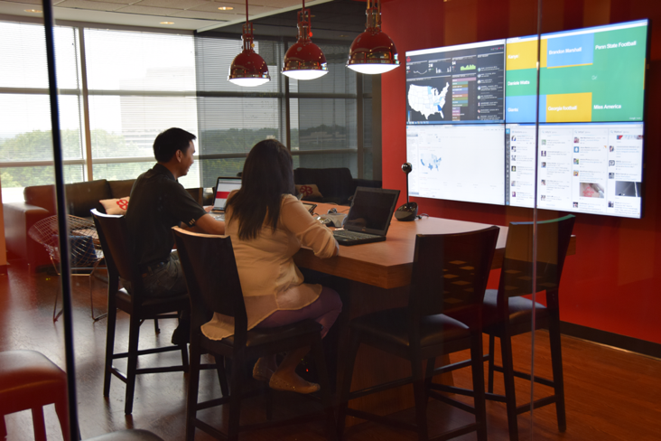
Listen First

Slide 3
OUR SOCIAL POV
Focus on what people really care about
What We’re Looking For:
Quality vs. Quantity
Authentic
Differentiated
Contextually Relevant / Targeted
What We Want to Avoid:
Forced
Lifestyle
Cute
#shakeupshow
@Jmart730

Slide 4
OUR PERSONALITY
WITTY
BOLD
CONFIDENT
GENUINE
We make clever
observations
We speak without
hesitation or regret
We’re proud of
who we are
We stay true
to ourselves
DOs
Make quick, relevant remarks
Be self deprecating when appropriate
Come off smarter to fewer
DON’Ts
Take ourselves too seriously
Using puns, dad humor, slapstick
Be needy / “try too hard” or forced
THINK
Inside jokes, Banter, Personal humor, Sharp, Insightful
DOs
Be surprising & different
Speak our mind
Take risks
DON’Ts
Come off mean-spirited or defensive
Be afraid of judgement
Use exclamation points
THINK
Strong POV, Spontaneous Fearless, Obscure, Direct, Ballsy, Scrappy
DOs
Speak directly & simply
Know where we don’t belong
Only say it if it adds value
DON’Ts
Be cocky
Seek affirmation
Overthink it
THINK
Unspoken pride, Knowledgeable, Unapologetic, Unbothered
DOs
Present ourselves as a true fan
Come off approachable / relatable
Be consistent
DON’Ts
Look like every other brand
Try to be everything to everyone
Try to be something we’re not
THINK
Self aware, Permission to be there, Real, Legit, Straight shooter, No BS

Slide 5
NICHE AREAS
TV/Film
Anime
Beyond
Gaming/Nerd+:
Sci-Fi
Nerds
Weightlifting
Comic
Nostalgia
Sports
Events
TV
Wrestling
Launch
Motorcycle
Weightlifting
Literary
Motorcycle
Launch
Fantasy
Science/Math
Wrestling
Gamers
Cosplay
Sports
Makers
Events
#shakeupshow
@Jmart730

Slide 6
MONTHLY CONTENT MIX
Expand
Explore
Mass
Arby’s Fan
Sell Focused
Holidays
Culture Moments
Common Knowledge
Geek Interests
20%
60%
New Audiences
20%
#shakeupshow
@Jmart730

Slide 7
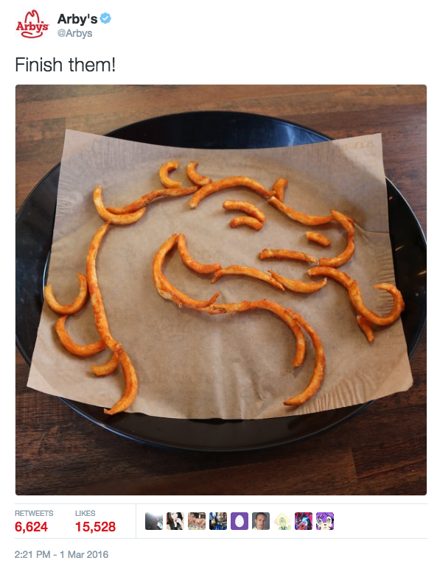
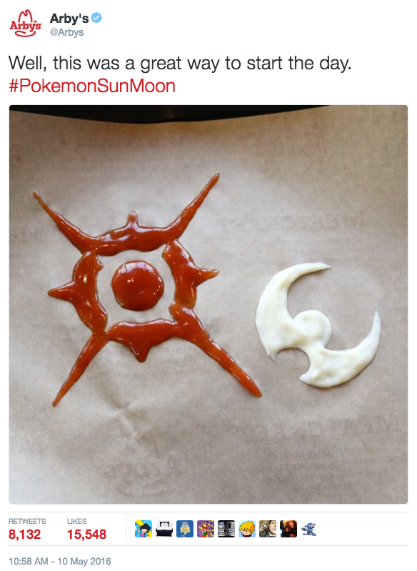
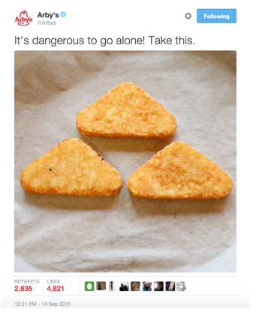
Posts That Make Us Proud
#shakeupshow
@Jmart730

Slide 8
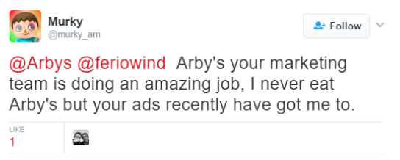
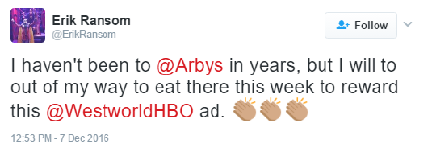

Slide 9
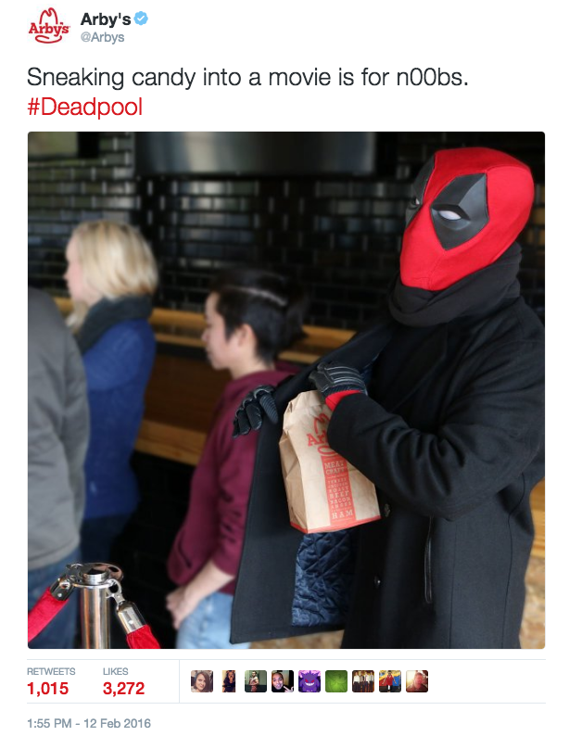
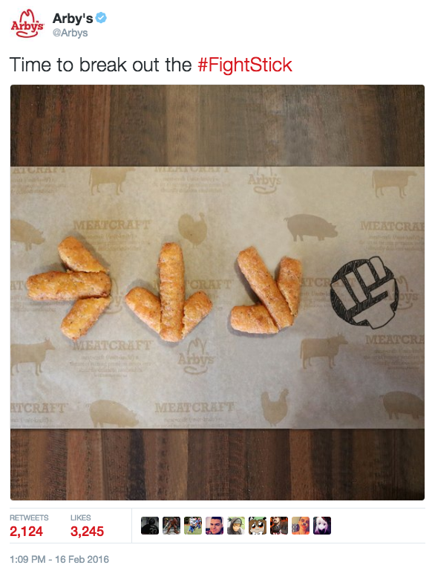
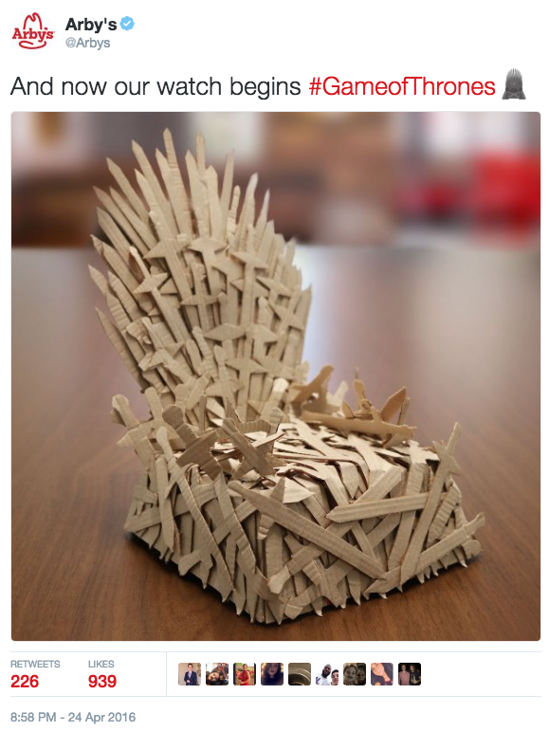
Posts That Make Us Proud
#shakeupshow
@Jmart730

Slide 10
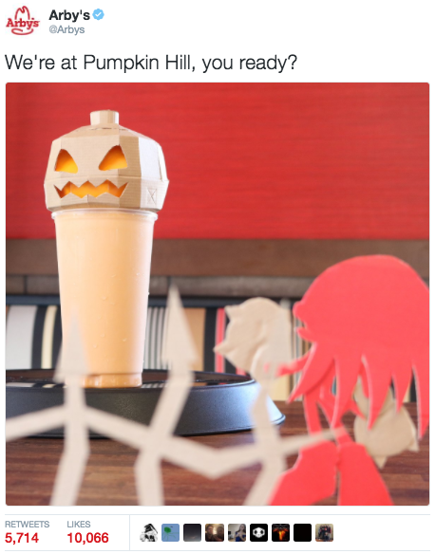
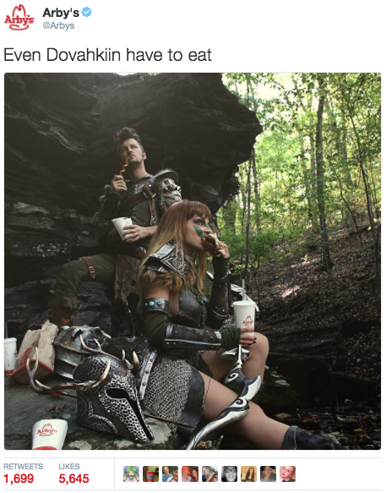
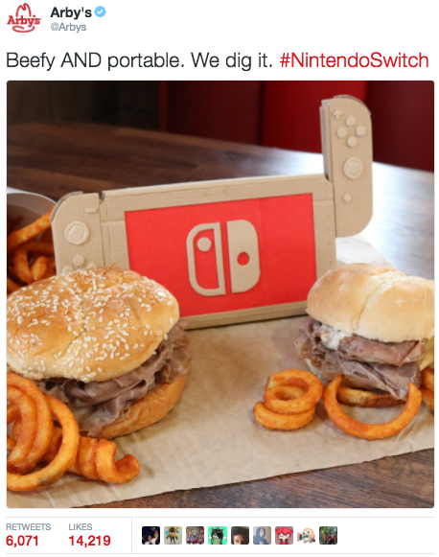
Posts That Make Us Proud
#shakeupshow
@Jmart730

Slide 11
KEY TAKEAWAYS
Listen to your audience
Don’t be afraid to test & learn
Be different
Focus on what people really care about
#shakeupshow
@Jmart730

